Slide 1
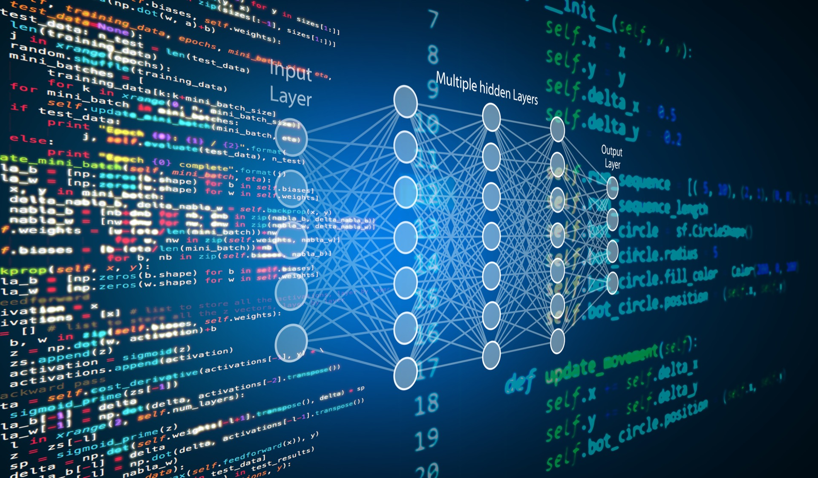
Welcome to our escape game !
Are you ready to become the best Data scientist ? Like the very best ? Like no one ever was ?

Slide 2
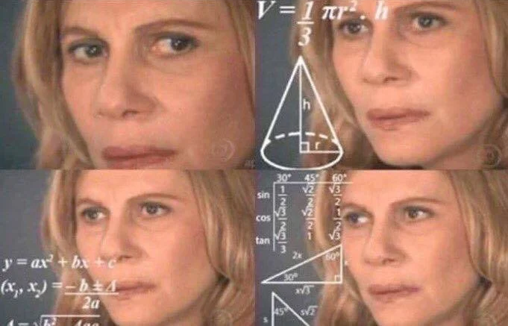
Here we are in the M1 SSD in Montpellier,
so you will be tested on some questions, may they guide you on your spiritual journey.

Slide 3
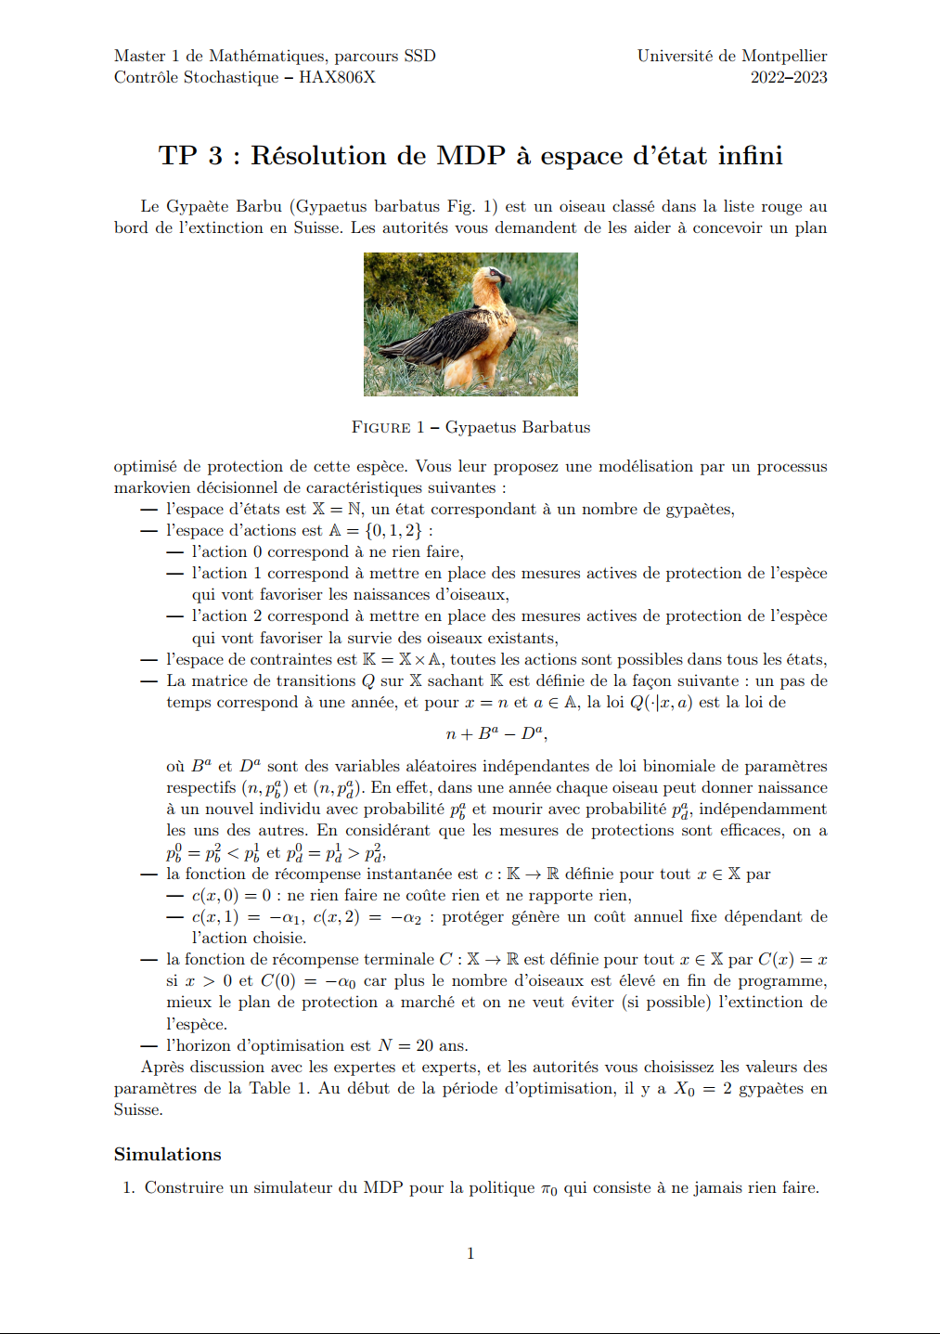
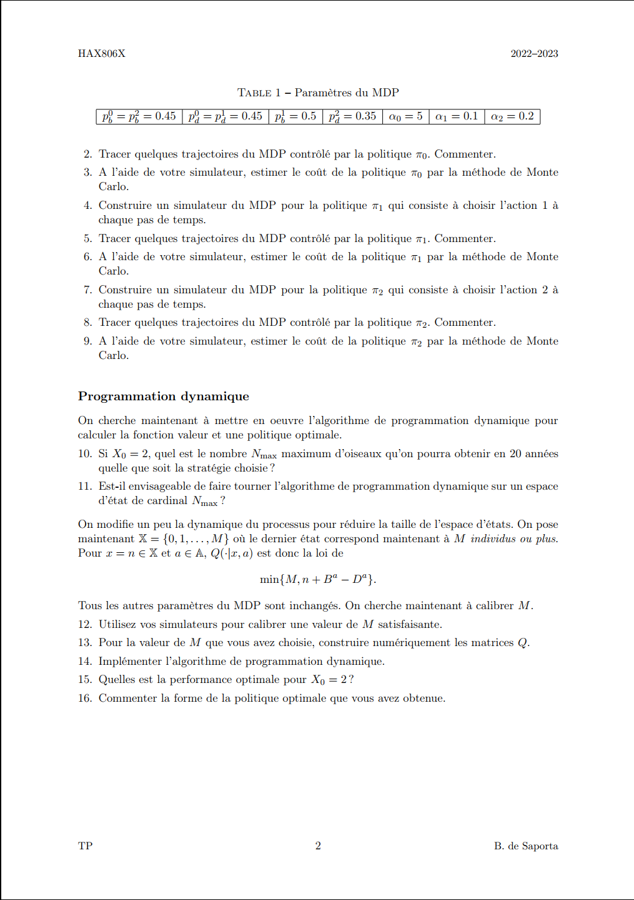
First things first, a fun, quick one :
Take your time and please, send your answers to paul.crespin
@etu.umontpellier.fr

Slide 4
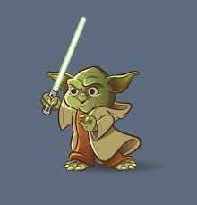
DATA SCIENTIST
ARE CALLED ?
A – Data scientist
B – Computer scientist
C – Jedi of regularity
D – Guardian of the
Temple of Regularity

Slide 5
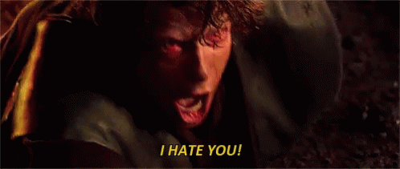
Average Computer sciencist according to Gilles Ducharme

Slide 6

The best Data scientist
is the one who…
A – Upgrade his competences
B – Upgrade his competences
C – Upgrade his competences
D – Other things ?

Slide 7
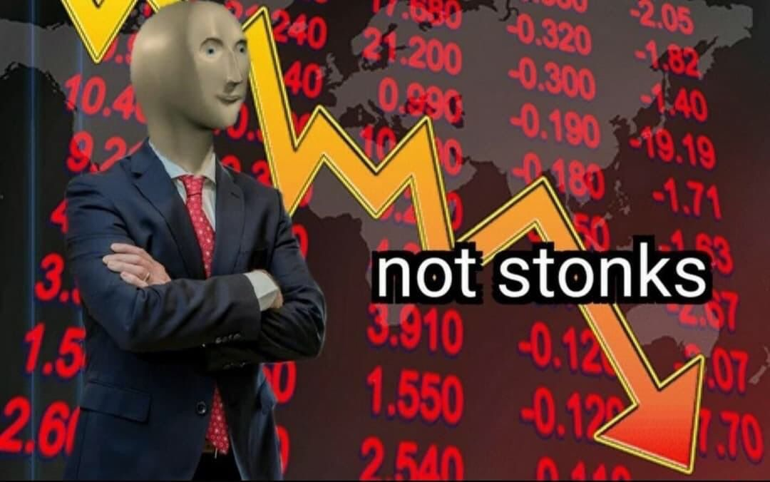
Mohammadi Bijan be like :

Slide 8
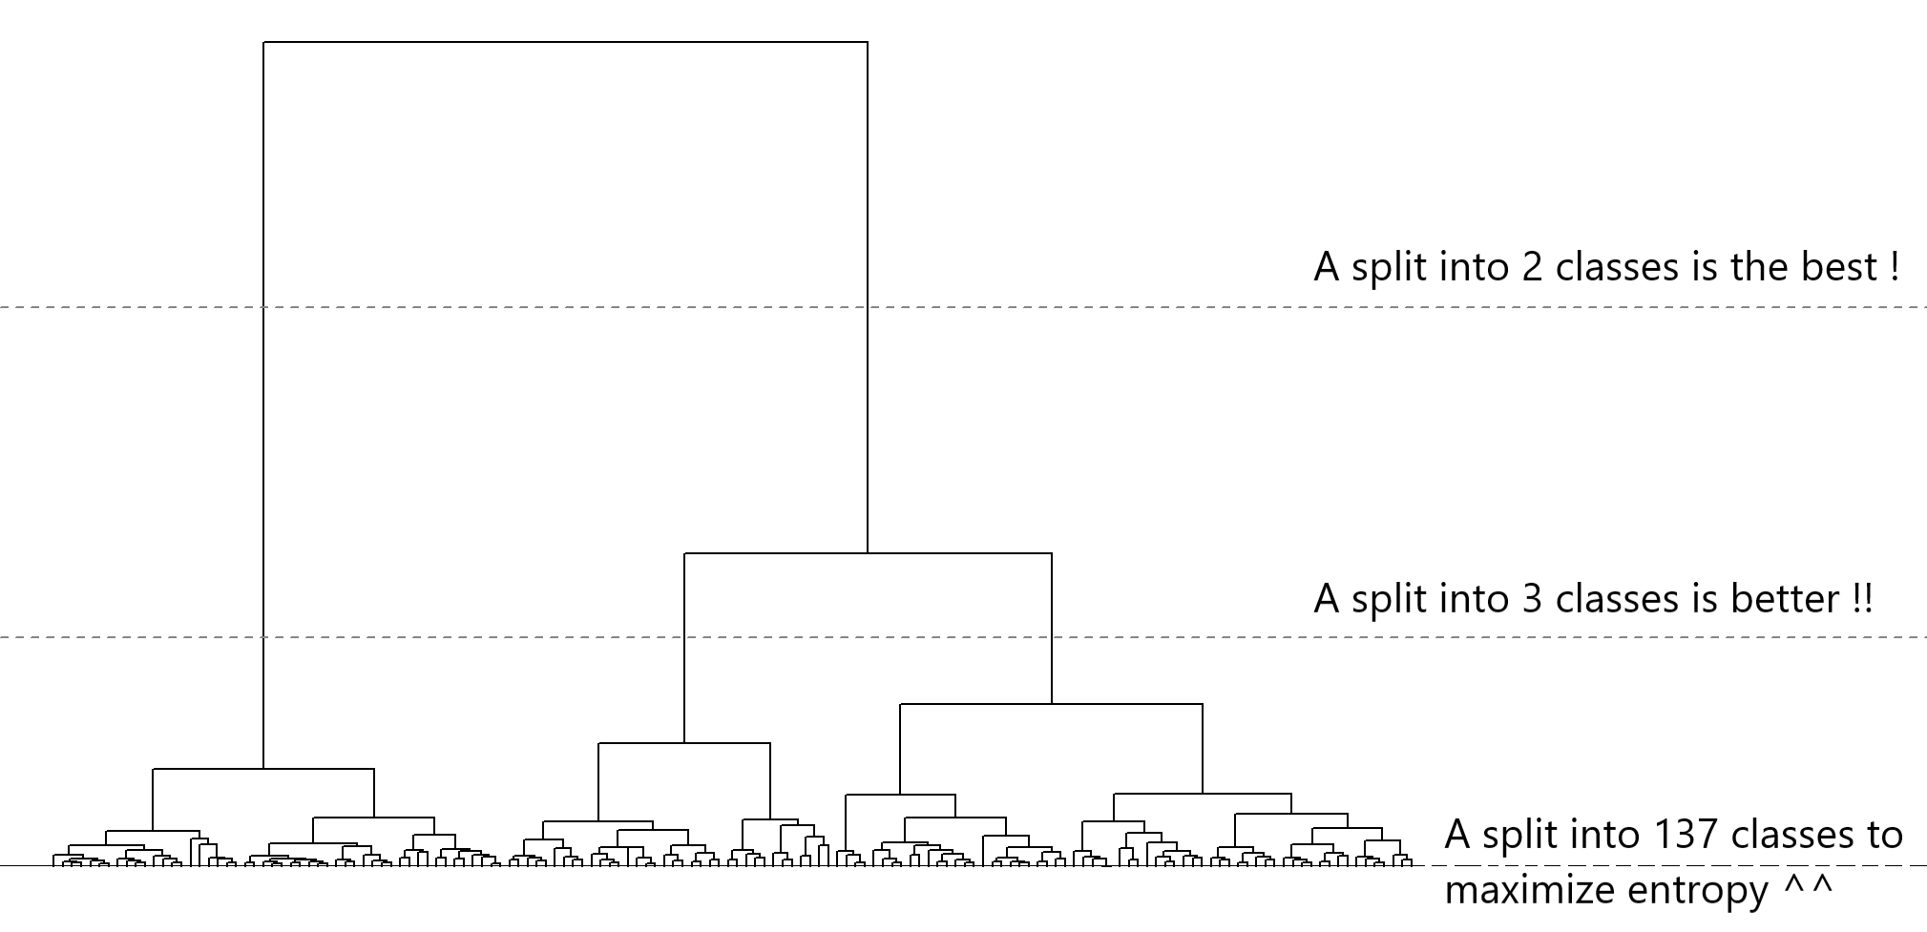

Slide 9
Congrats !

